Slide 1
ASBO International Non-ERISA
Governmental Model Plan
––––––––––––––––––––––––
Non ERISA Plans Primer

Slide 2




History of the 403(b)
  Participation is voluntary
  Employees or their beneficiaries maintain all rights under the annuity contract or custodial accounts
  Employer Involvement is limited to:
  Make available choice of 403(b) eligible products and their brokers or agents
  Requesting information on proposed funding media (product)
  Summarizing funding media (product) information
  Facilitating the remittance and maintain Salary Reduction Agreements
  Holding in the ER’s name (name only) one or more group annuity contracts
29 CFR ss 2510.3-2 is the
initial broad exemption established in 1954

Slide 3
History of the 403(b)
The number of employees affected
The number of contractors who have indicated interest
The variety and features of available products
The terms of the available arrangements
The administrative burden and costs associated
to the ER
Workplace interruptions
After February 6th, 1978, a relevant circumstances provision, thereby, providing reasonable choice limitations must consider:

Slide 4
History of the 403(b)
School Districts are not currently subject to fiduciary obligations at a federal level
School Districts are subject to fiduciary requirements at the state level found in the Prudent Investor and Laws of Wills and Common Trusts statutes influenced by the Uniform Management of Public Employee Retirement System Act (UMPERSA)
UMPERSA imposes a prudent standard for the main employee retirement system of states. It excludes 403(b)s, but, as states adopt 403(b)s, such language is used in state law.
Districts should move with caution when limiting choice, engaging in the plan design and management, as to follow exemption requirements nor impugn Sovereign Immunity statutes
This is significant as a district could expose themselves to claims that it had in fact taken a fiduciary role
This increases a districts risk and responsibility
This increases the administrative burden of the district

Slide 5
Employer Responsibility
––––––––––––––––––––––––
Non ERISA Plans Primer

Slide 6


Employer Responsibility in Non-ERISA 403(b)
Plan Sponsor or Administrator Responsibilities
      Plan qualification & establishment
        Plan Document
        Plan Amendments
        Written policies and procedures
        Information sharing agreements
      Contributions
        Process for universal availability notice
        Mechanism to enforce statutory limits
        Aggregate additional plans if required

Slide 7
Employer Responsibility in Non-ERISA 403(b)
Plan Sponsor or Administrator Responsibilities
      Transactions
        Aggregate data to ensure compliance with all plan level restrictions for approval of transactions
        Determine accuracy of SPARK file or other data sharing information
      Enrollment
        Evaluate & determine eligibility
        Mechanism for Salary Reduction Agreement and Product enrollment
        Review investment provider list and media

Slide 8
Employer Responsibility in Non-ERISA 403(b)
The plan sponsor may:
    Engage in a range of activities to facilitate the operation of the program
    Permit investment providers—including agents or brokers who offer annuity contracts/custodial accounts—to publicize their products
    Request information concerning proposed funding media, products, or annuity contractors
    Compile investment information to facilitate review and analysis by the employees
    Enter into salary reduction agreements and collect annuity or custodial account considerations required by the agreements, remit them to the providers, and maintain records of such collections
    Hold one or more group annuity contracts in the employer’s name covering its employees and exercise rights as representative of its employees under the contract, at least with respect to amendments of the contract

Slide 9
Employer Responsibility in Non-ERISA 403(b)
The plan sponsor may:
      Limit funding media or products available to employees, or annuity contractors that may approach the employees, to a number and selection designed to afford employees a reasonable choice in light of all relevant circumstances
      Certify to an annuity provider a statement of facts within the employer's knowledge as employer, such as employee addresses, attendance records or compensation levels
      Transmit to the investment provider another party's certification as to other facts, such as a doctor's certification of the employee's physical condition
      Identify in the plan the parties that are responsible for administrative functions, including those related to tax compliance. The plan should correctly describe the employer’s limited role and allocate discretionary determinations to the vendors/investment provider(s)
      Discontinue a provider due to non-compliance with 403(b) regulations or inclusion of optional features;
      Refuse vendors whose operational practices force an employer to make discretionary decisions

Slide 10
Employer Responsibility in Non-ERISA 403(b)
The plan sponsor may not:
        Permit any type of employer contributions under the plan
        Have responsibility for, or make, discretionary determinations in administering any part of the 403(b) plan/program
        Make discretionary decisions including authorizing plan-to-plan transfers; processing distributions, including hardship distributions; determining whether a domestic relations order (QDRO) is qualified; and determining eligibility for and enforcement of loans
        Limit investments to one provider (Field Assistance Bulletin (FAB) 2010-01 permits “reasonable choice” for cost considerations where, for example, multiple investments are available under a broker/dealer or an “open architecture” program)

Slide 11





Employer Responsibility in Non-ERISA 403(b)
The Wisconsin Court of Appeals stated an action alleging a failure to exercise ordinary care in the administration of a 403(b) plan…, if proven, may entitle the Retirees to relief in state court.
Current class action litigation in the higher education market is focused exclusively on ERISA plan sponsors
Class action litigation against Federal Thrift Savings Plan regarding core services
Employer responsibility is primarily found in the Internal Revenue Code relating to plan establishment, plan administration, and plan terminations
State common law can apply to 403(b) to include contract theories and agent theories
Federal securities laws related to the purchase of contracts and deposit of premiums can also apply
Employers need to be careful of misrepresentation, state security violations, employment law violations, various insurance law claims and consumer protection violations

Slide 12
Participant Protection & Outcomes
––––––––––––––––––––––––
Non ERISA Plans Primer

Slide 13
Participant Protection & Outcomes
State Statutes
  Participants are provided some level of protections found in enabling state statutes
    Prudent Investor
    Laws of Wills & Common Trusts
  Additional protections can be found in some states where there are additional standards of care imposed
    Fee disclosure
    Firm or agent fiduciary standard of care
Regulatory Oversight
  The Internal Revenue Code does set forth certain annuity and custodial accounts as “403(b) eligible products”
  All 403(b) eligible products have some form of State, Federal, or combined oversight.
  Fiduciary rule and best interest provisions provide significant participant protection enhancements

Slide 14
Participant Protection & Outcomes
Product | Federal or State Agency with Oversight
Annuities | State(s) Department of Insurance
40 Act Mutual Funds | SEC and/or FINRA
Registered Investment Advisor | State Agency (Typically State Treasurer or Finance Division) and FINRA and/or SEC

Slide 15
Overview of Model Plan
––––––––––––––––––––––––
Non ERISA Plans Primer

Slide 16

Model Plan Overview
Independent Third Party Administration
  Largest TPA in the U.S.A
  Chosen via RFP Process
  Over 6,000 employers in 48 states nationwide representing over 9,000 plans, 3.2 million participants, and over $100 billion in assets under care.
  Offices in Citrus Heights, CA (9 EE’s), Fort Walton Beach, FL (83 EE’s), and Rochester, NY (50 EE’s).
Core Investment Provider Line Up
Responded to RFI focused on:
  Compliance
  Market Commitment
  Participant Education
  Fee Disclosure
Wild Card Investment Provider
1. Responded to RFI.
2. Selected based upon:
  Geographic coverage
  Current product offerings

Slide 17
Respondents Product Offerings
Providers and
Investment Product Array
Investment Provider | Fixed +/or Stable Value | Variable Annuity | Mutual Fund | 403(b) | 457(b)
American Fidelity | • | • |  | • | •
Ameriprise | • | • | • | • | No
Aspire | • |  | • | • | •
Equitable | • | • |  | • | •
American Century | • |  | • | • | •
Horace Mann | • | • |  | • | •
National Life Group | • |  |  | • | •
Kades-Margolis | • | • | • | • | •
Oldham Resources | • |  | • | • | •
PlanMember Services | • |  | • | • | •
Security Benefit | • |  | • | • | •
Lincoln Investment | • |  | • | • | •
WEA | • |  | • | • | No
Voya Financial | • | • |  | • | •

Slide 18
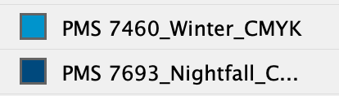
Review Vendor Construct
Review share classes under State “prudent investor” standard of care
    American Century Investments
    Equitable
    National Life Group
    Horace Mann
    Security Benefit
    Voya Financial
Mutual Funds
Guaranteed Products
Help Me
Mutual Funds
Guaranteed Products
I’ll Do It

Slide 19
Core Services for Model Plan
1
Plan Document & IRS Audit Support
2
Plan Support
Services
3
Plan Participant
Support
4
Services
Platform
Volume Submitter Plan Document & All Required Amendments
Onsite Audit Support
Investment Provider Selection & Management
Advisor Selection & Management
Common Remitting Services
  Data Aggregation
  Transaction Approvals
  Salary Reduction Agreements
  Online or on the phone
Employer can manage all services thru one platform page

Slide 20
Core Services for Model Plan
Is employer eligible
Adopt and update plan document
Plan operations in line with plan document
UA for salary deferrals to employees
Monitor contribution limits
Monitor loans & hardships
Adjudicate all transactions
Manage Investment Providers & Onsite Advisors

Slide 21
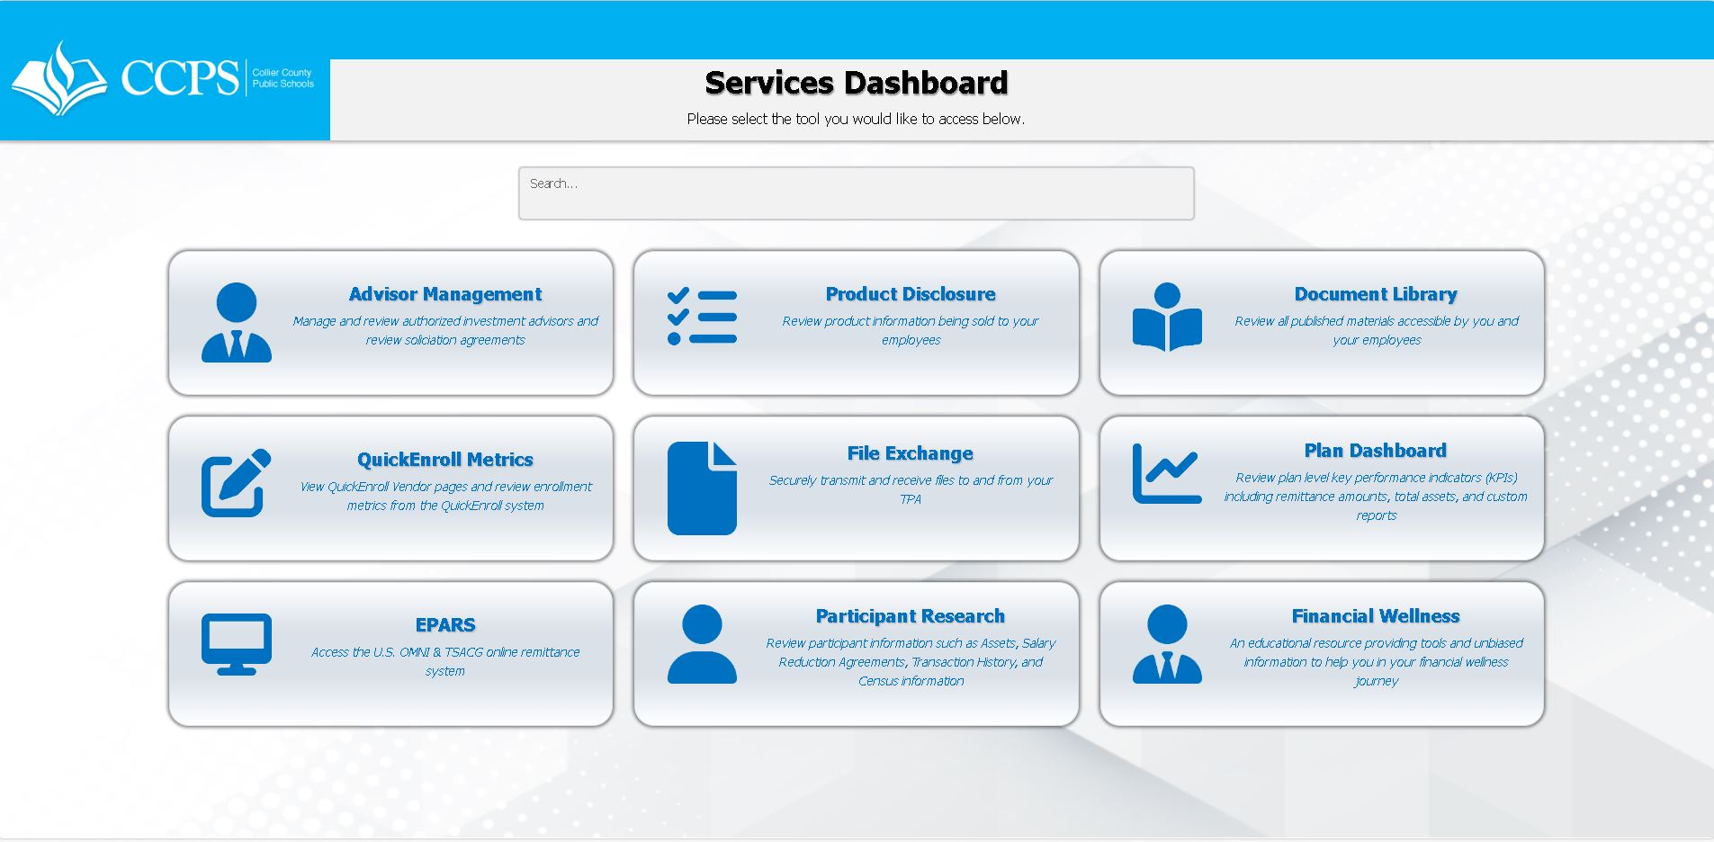
Employer Services Dashboard
Employer Services Dashboard (mytsalogin.com)

Slide 22
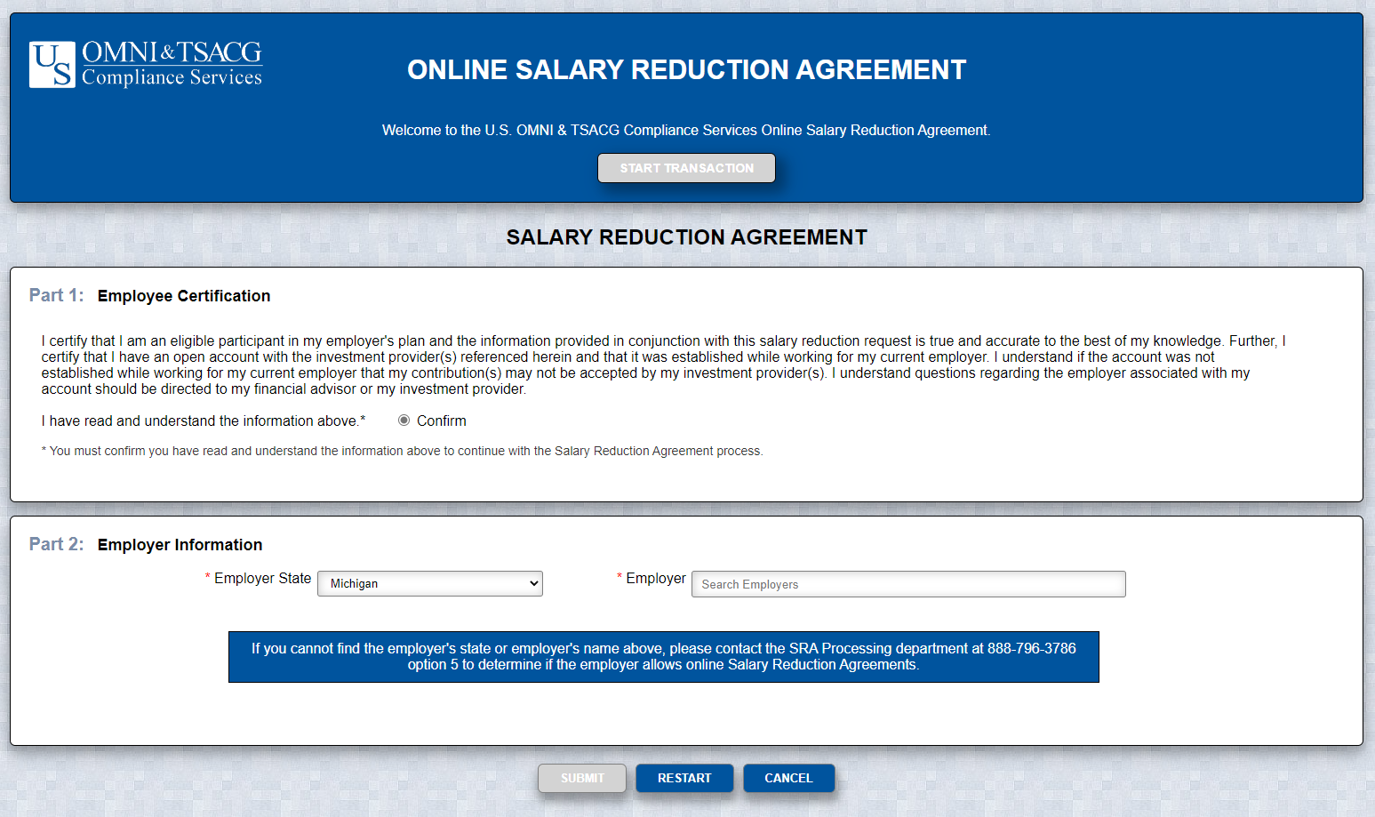
Online SRA Processing
Easy Setup
% or $
Account Verification/
Eliminate Refunds
IRS Audit Records

Slide 23

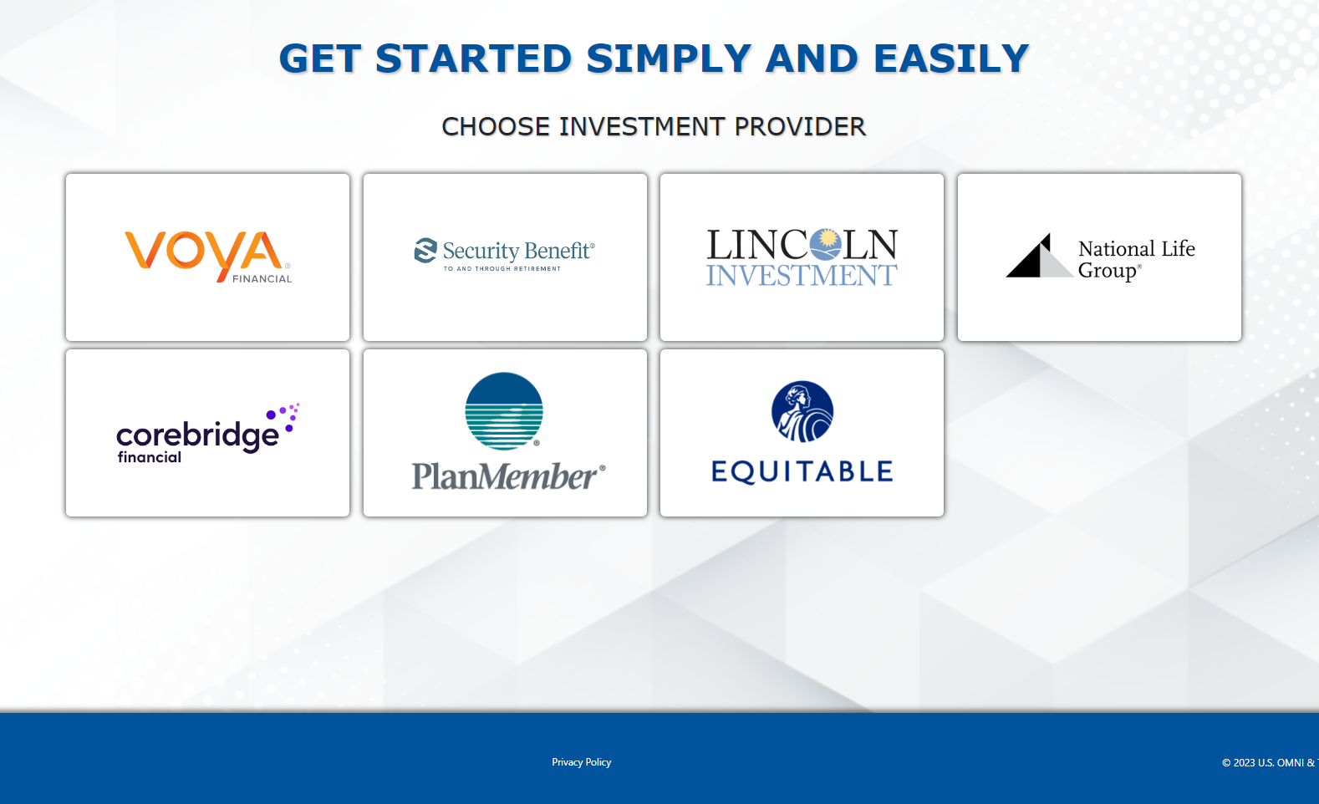
QuickENROLL

Slide 24

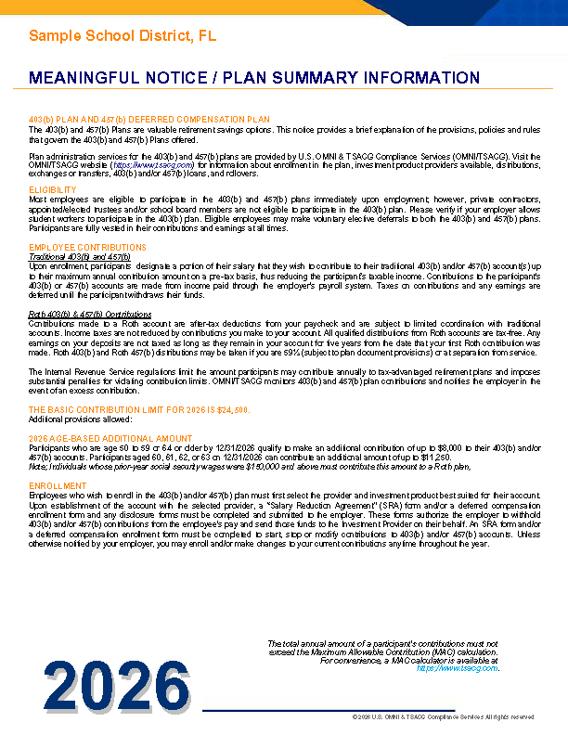
Meaningful Notice
IRS Universal Availability Rules
If you allow one employee to make 403(b) contributions, you must allow all employees (w/ few exceptions)
Employers must notify all eligible employees ANNUALLY

Slide 25
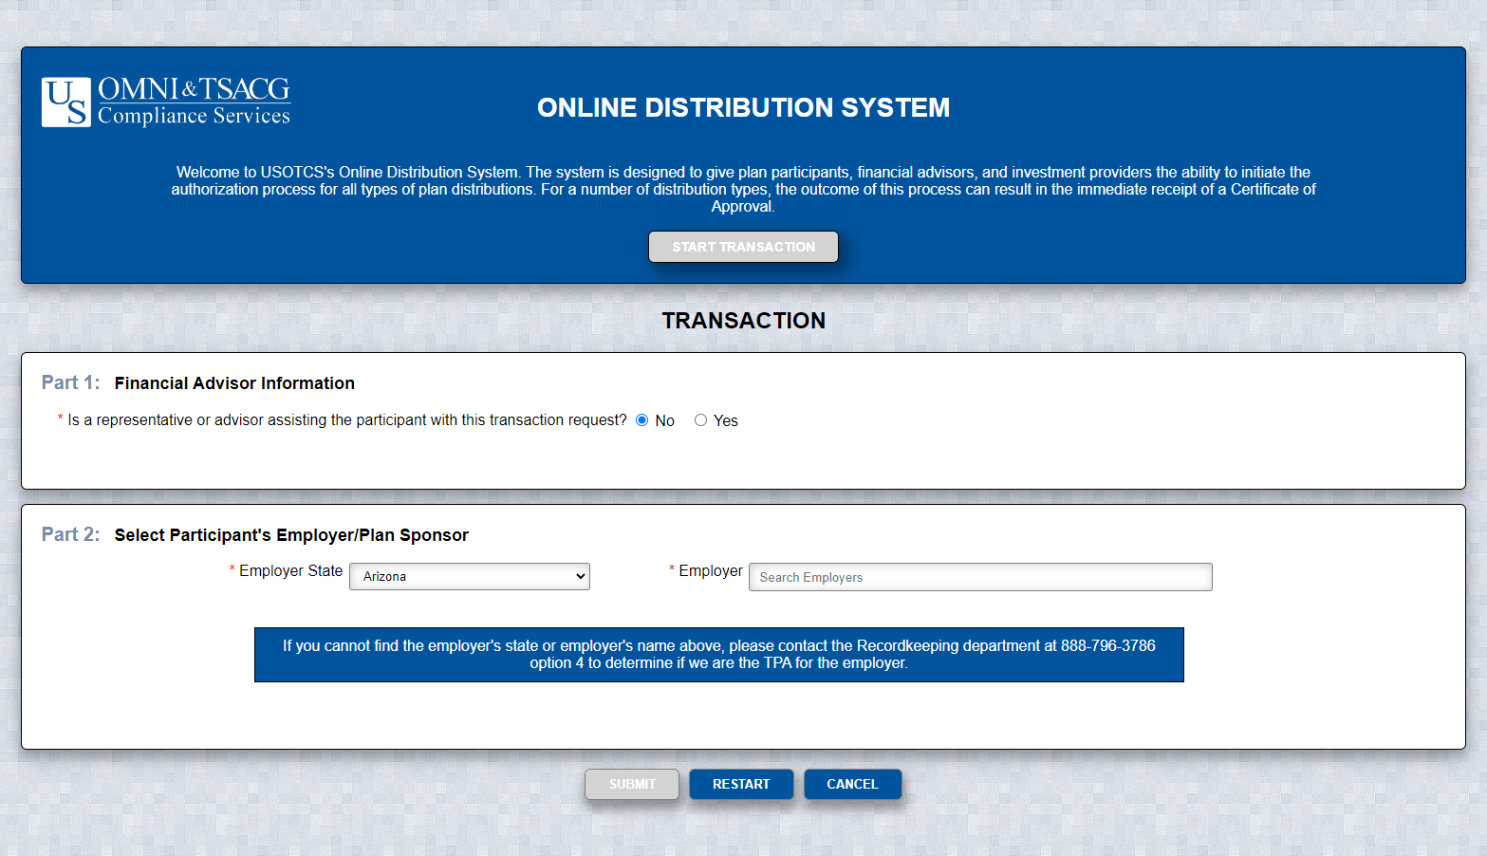
Online Distribution System
Secure
Fast (Instant approval
for most transactions)
Available 24/7

Slide 26
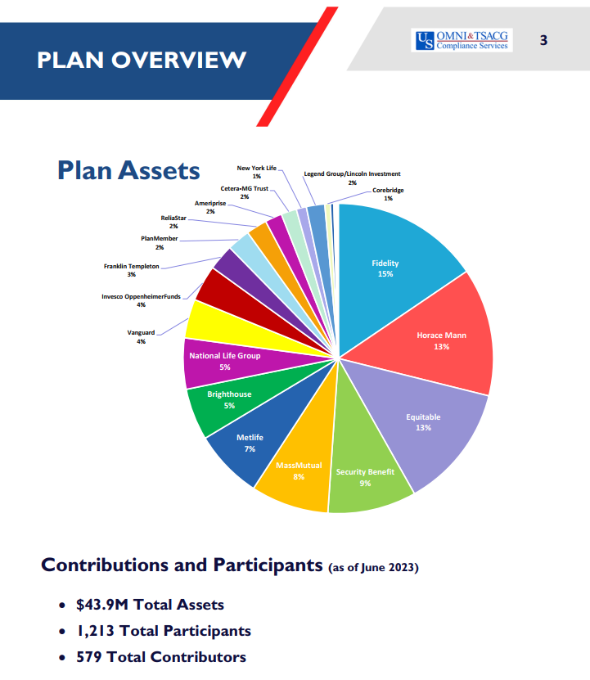
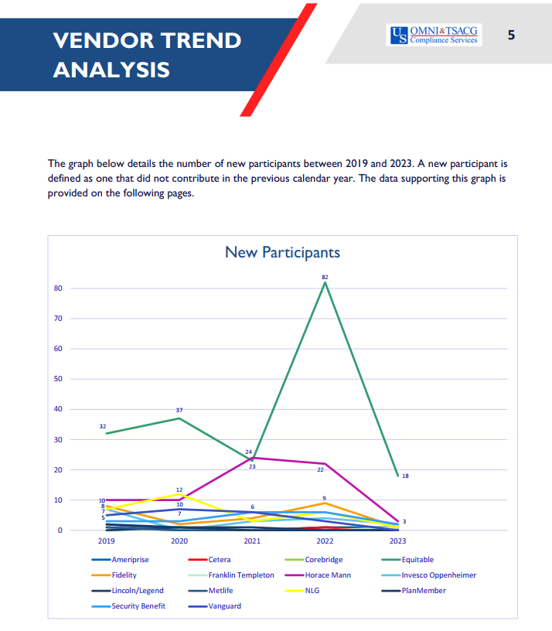
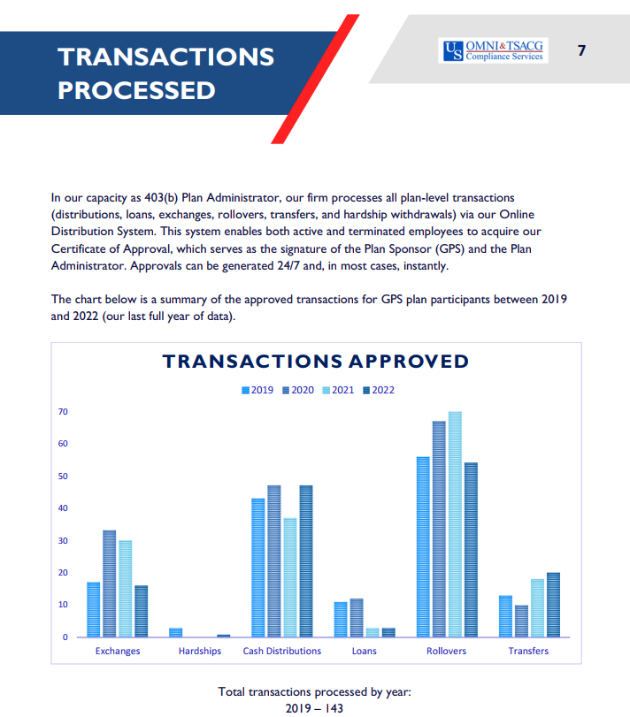
Plan Governance: Plan-Level Reporting
OMNI/TSACG receives data from 125+ vendors
  Assets, Contributors, and Participants by Vendor
  YTD Contributions by Vendor
  New Enrollments by Vendor
  Transactions by Type
  Participation by Age and Work Site

Slide 27
United States + Legend + Shaded States
Editable PowerPoint Version.
State Labels are grouped.
Map is grouped.
Both are grouped together.
Support Team Map
Consultants
  Robert Ard + Justin Rollins
  Robert Ard
  rard@tsacg.com
  888-777-5827, x1124
  Paul Bottoms
  pbottoms@tsacg.com
  888-777-5827, x1106
  Jamila McDuffie
  jmcduffie@omni403b.com
  877-544-6664, x106
  Eric Miller
  emiller@tsacg.com
  888-777-5827, x1125
  Ryan Phillips
  rphillips@omni403b.com
  877-544-6664,x 181
  Justin Rollins
  jdrollins@tsacg.com
  888-777-5827, x1126
WA
MT
ND
ME
OR
MN
VT
ID
WI
NH
WY
SD
NY
MA
MI
CT
RI
NE
IA
PA
NV
OH
NJ
UT
IL
IN
DE
CA
CO
WV
DC
KS
MO
KY
VA
TN
NC
AZ
NM
OK
AR
SC
MS
AL
GA
TX
LA
AK
FL
HI

Slide 28
Questions?

